Slide 1
Assignment 1
Personal Statement or Cover Letter

Slide 2
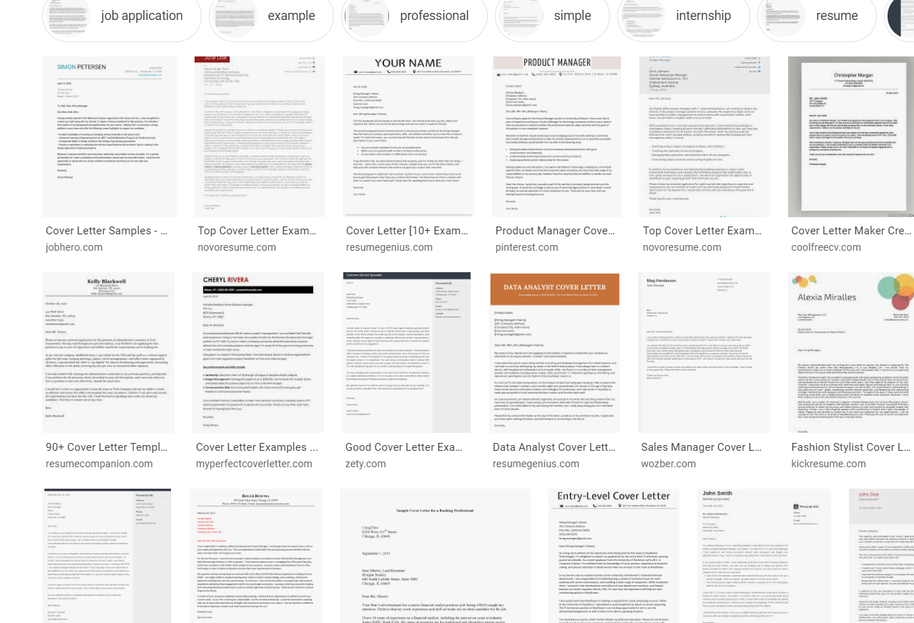

Slide 3
Personal Statement & Cover Letter
Make them effective by demonstrating
Written and organizational skills
Write clear topic sentences that are effective and efficient
Achievements should be mentioned in the first sentence
Stick to one main point per paragraph
Why you are a good fit for the program
Practical experiences, school experiences, volunteering
Why the university/company should select you over others

Slide 4
Be Organized
It can be organized in paragraphs or sections of paragraphs.
Have one main idea per paragraph.
Personal story, experiences, achievements, appeal to university
Introduce that main and most important idea first.

Slide 5
What not to do
Do not get too personal.
Do not give overly negative examples
Do not just repeat resume bullet points.
Focus on the story behind those bullet points.

Slide 6
Personal Statement -- main areas to cover:
Personal anecdote--why do you want to study?
What have you done in the past that will contribute toward the course, program, university, or community? Talk about your experiences.
If you don’t have much experience, you can talk about future goals.
How will you benefit from the school and how will the school benefit from you?
Make a direct appeal
Say what you know about school, program
Where could studying this program lead you? How will it help you grow?

Slide 7
Examples - Balancing personal and professional
“As an immigrant from a working class family with a single father, I have rarely met other students with similar backgrounds. While earning my B.A. at UNC-Chapel Hill, my awareness of being one of the few minority students in my classes only grew. As such, I realized not only the importance of graduate education in order to advance my own training, but to better serve the working class families in the communities in which I have lived, worked, and studied.”

Slide 8
Examples - Balancing Personal and Professional
“My brother’s substance use disorder aroused my interest in addiction and spurred me to choose clinical psychology for my life’s work. My goal is to understand the initiation and maintenance of addiction, what makes an intervention effective and how addiction impacts family members. Dr. Hussong’s research parallels my interests and the University of North Carolina provides the most conducive environment for fostering my growth as a researcher of addictive behaviors.”

Slide 9
Examples - Does not have to be personal at all
Since I can remember, I have been motivated to understand human thought, feeling, and behavior. I initially pursued a degree in Human Resources Management because of my fascination with people, and this experience solidified my passion for understanding human behavior. Although I enjoyed the program, I quickly realized that I was more interested in studying the intricacies of people’s behavior itself, rather than its application to business. This in turn led me to psychology, and it was here that I truly found my intellectual home. When I declared psychology as my major, I knew that I would continue with graduate studies in this field, and specifically, in the application of psychological science to ameliorating human problems. I am excited to pursue a doctoral degree in Clinical Psychology and conduct research in the area of intimate relationships, and I am enthusiastic about the prospect of completing my graduate studies at the University of North Carolina-Chapel Hill.

Slide 10
Cover letter
Differs from resume in that you talk about how you have been impacted by your experiences
Must be tailored with the specific employer in mind:
Show you know the specific needs of an employer and how you meet them.
Convince them that your goals align with theirs
Demonstrate how your skills and knowledge will help them

Slide 11
Cover Letter: What it does
Introduces you and your resume to an employer
Explains why you are writing/applying
Details why you are a good match
Demonstrates your abilities and helps establish credibility
Provides a sample of your written communication skills
Draws attention to specific qualities

